Slide 1
Goodchoice website
Ujian Tengah Semester PBW B

Slide 2
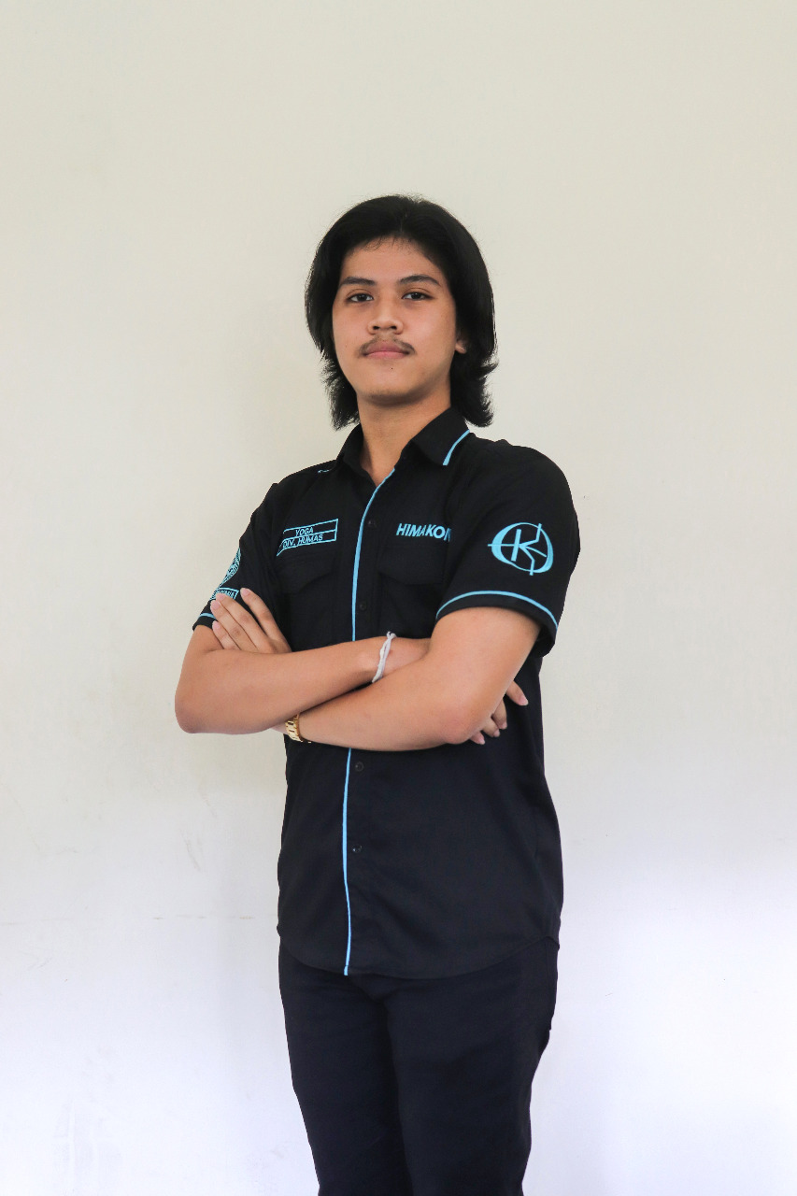
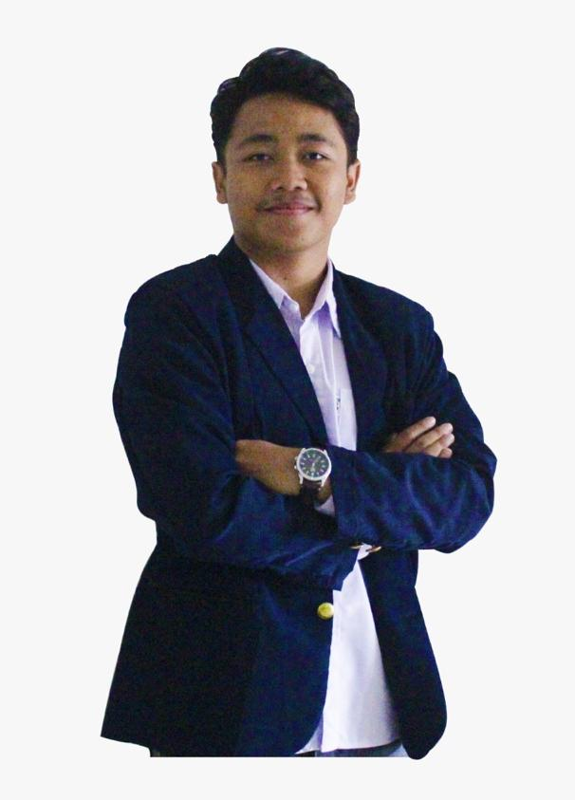
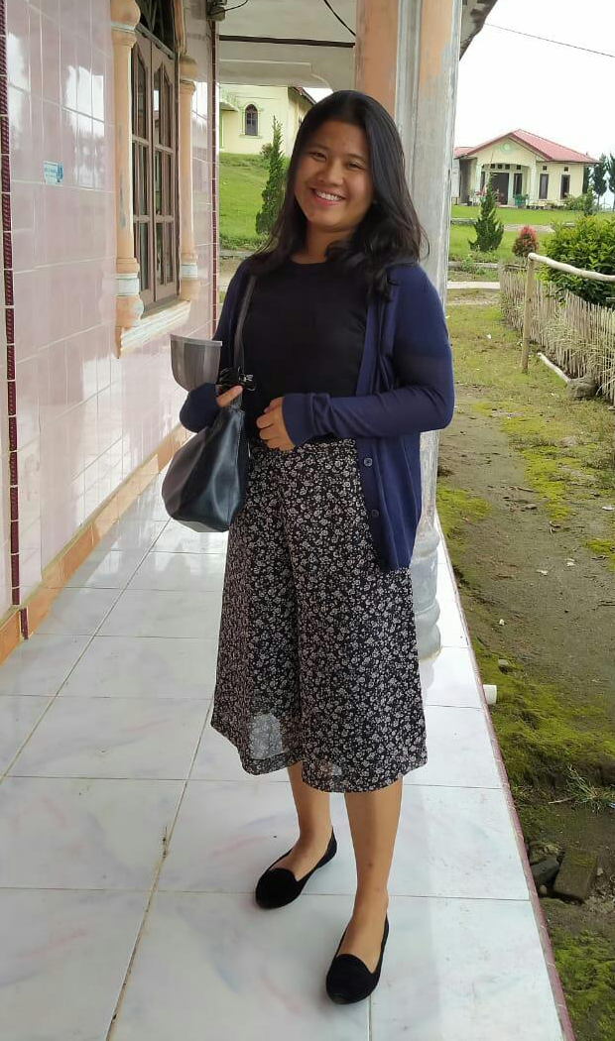
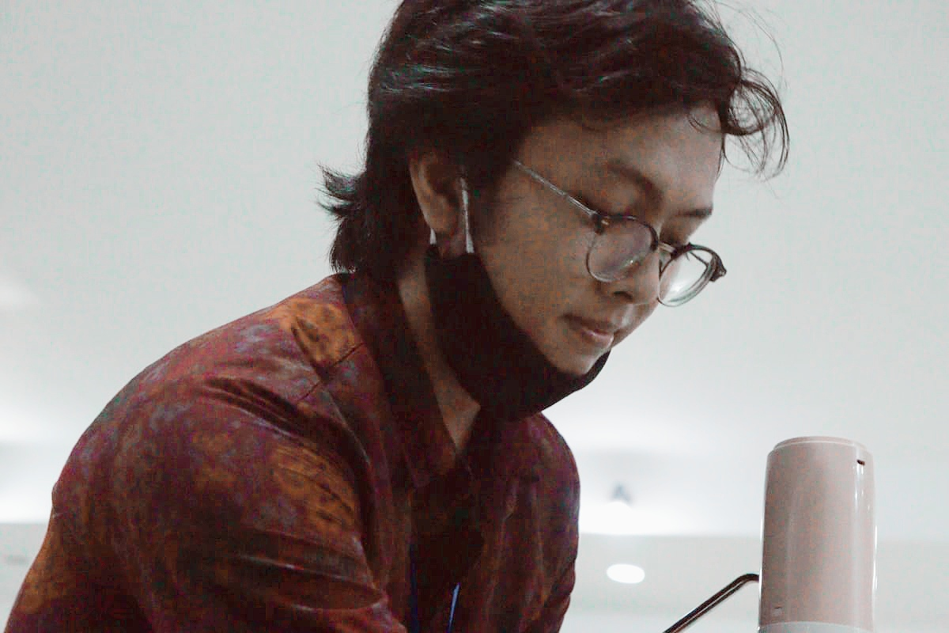
Our team
I Kadek Agus Chandra Pradika
Theresia Seftiani Girsang
I Putu Sedana Wijaya
I Made Yoga Mahendra
1808561025
1808561029
1808561034
1808561044

Slide 3

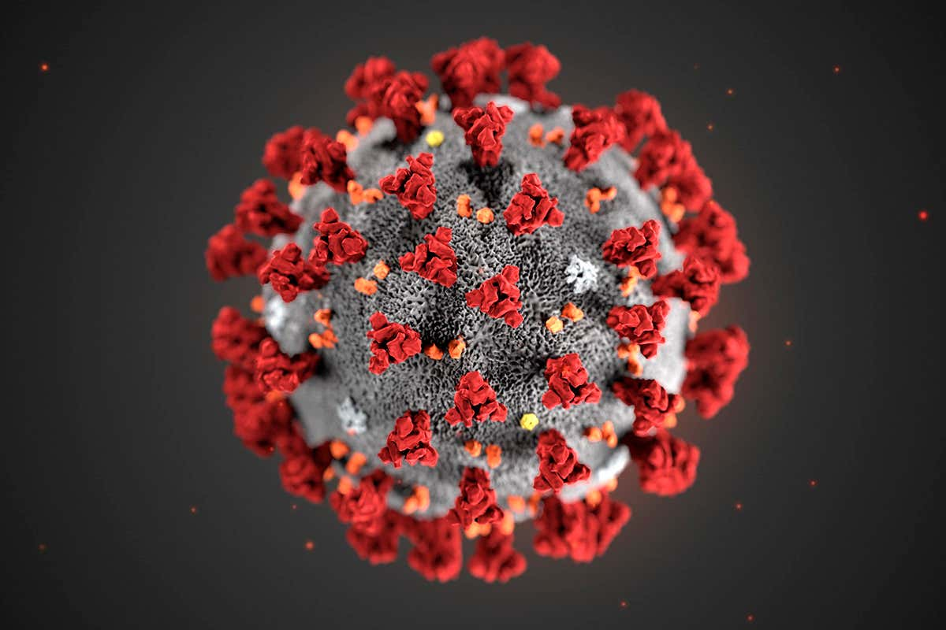

Latar Belakang
Covid-19
Pendidikan
Platform

Slide 4
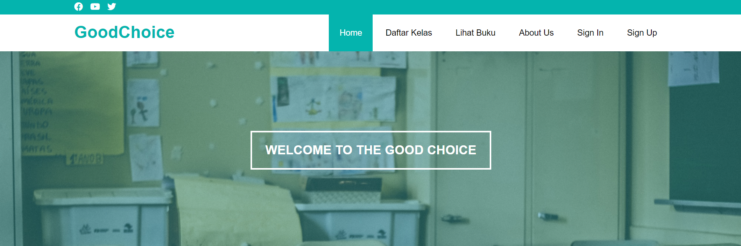
GoodChoice

Slide 5





Fitur
GoodChoice
Home
Daftar Kelas
Lihat Buku
Sign In/Sign Up
About Us

Slide 6

Demo

Slide 7
TERIMAKASIH
gOODcHOICE TEAM

